Slide 1
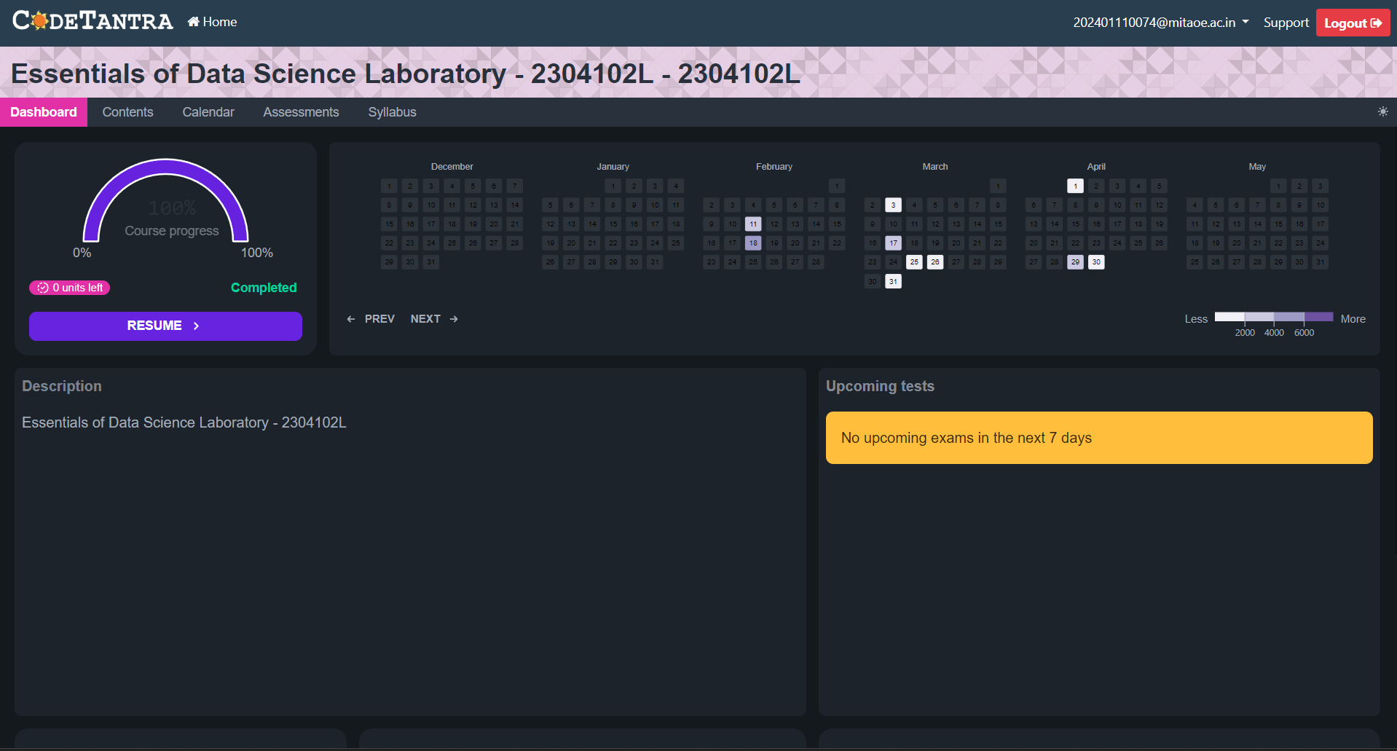
Name – Vineet Kaldate Prn – 202401110074 Roll no – CS7-87

Slide 2
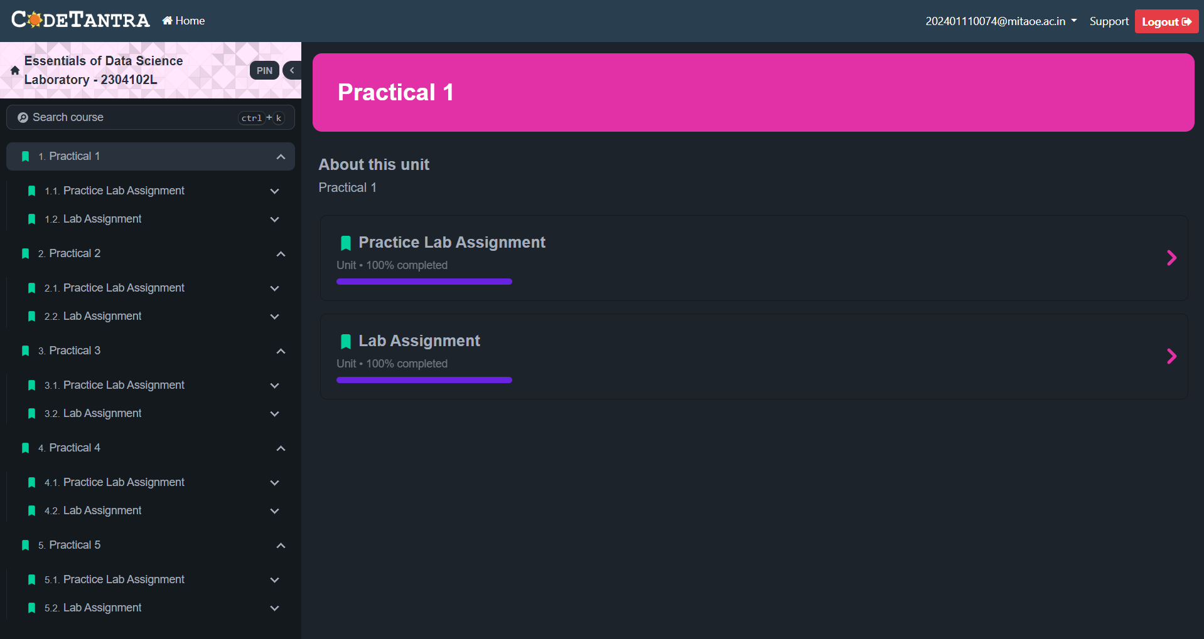

Slide 3
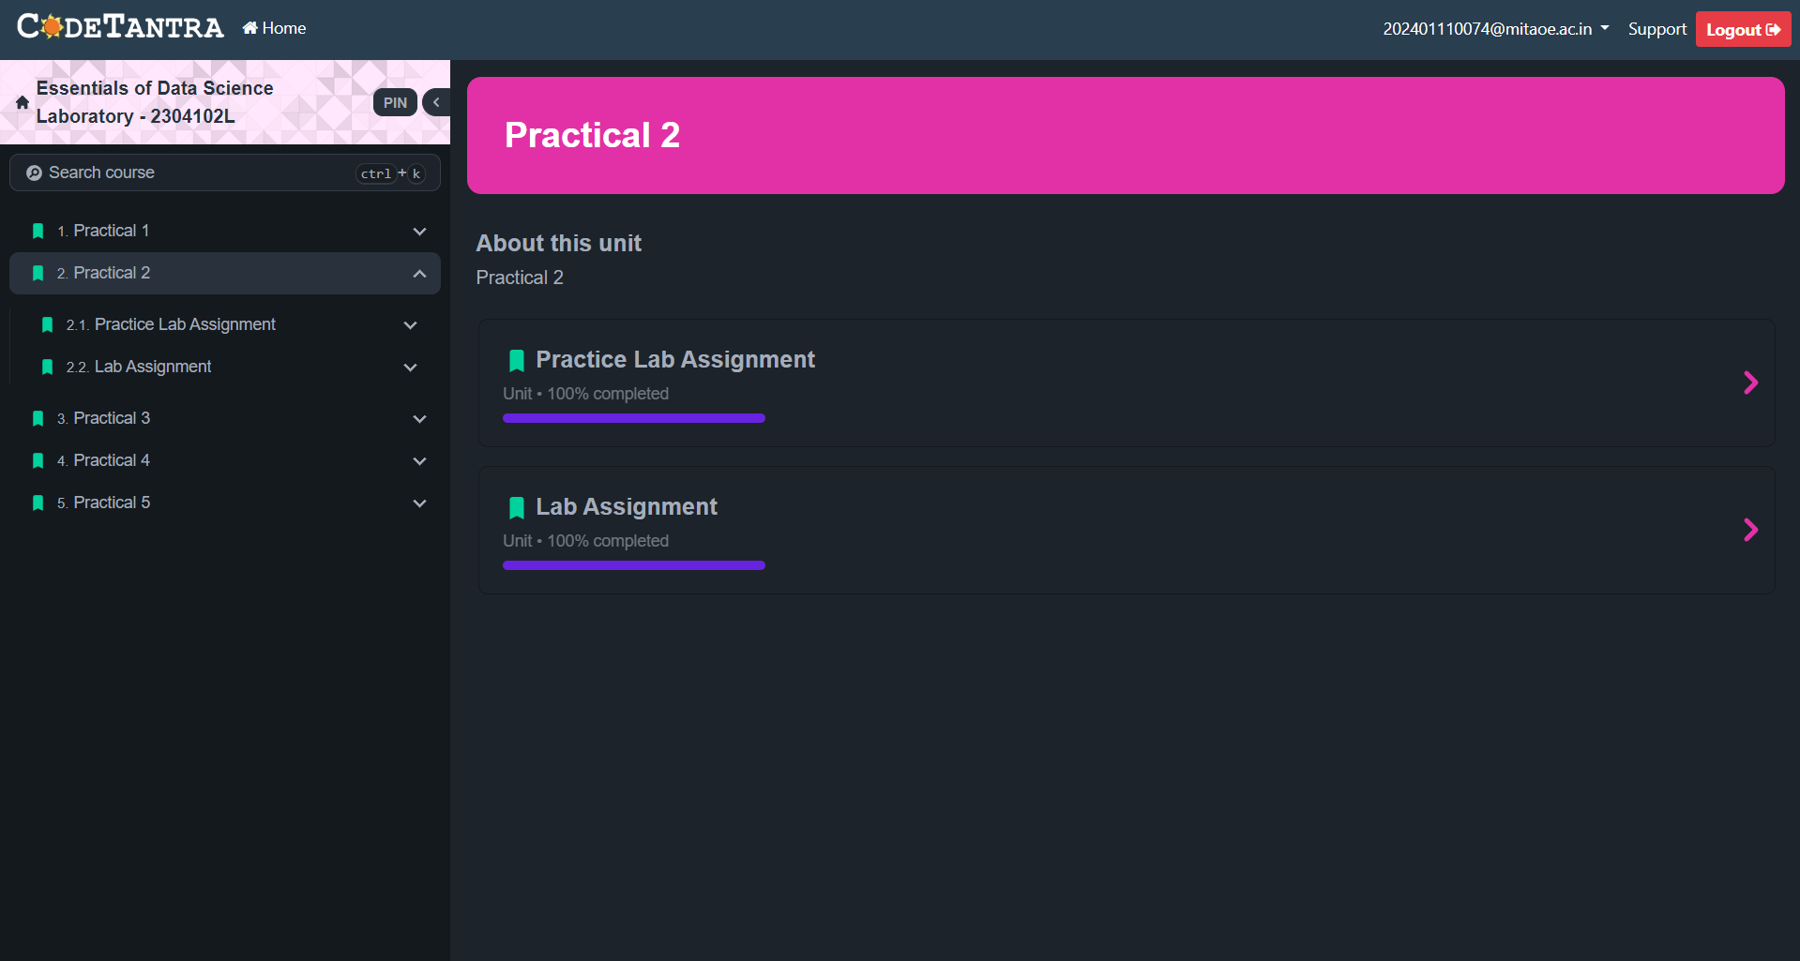

Slide 4


Slide 5
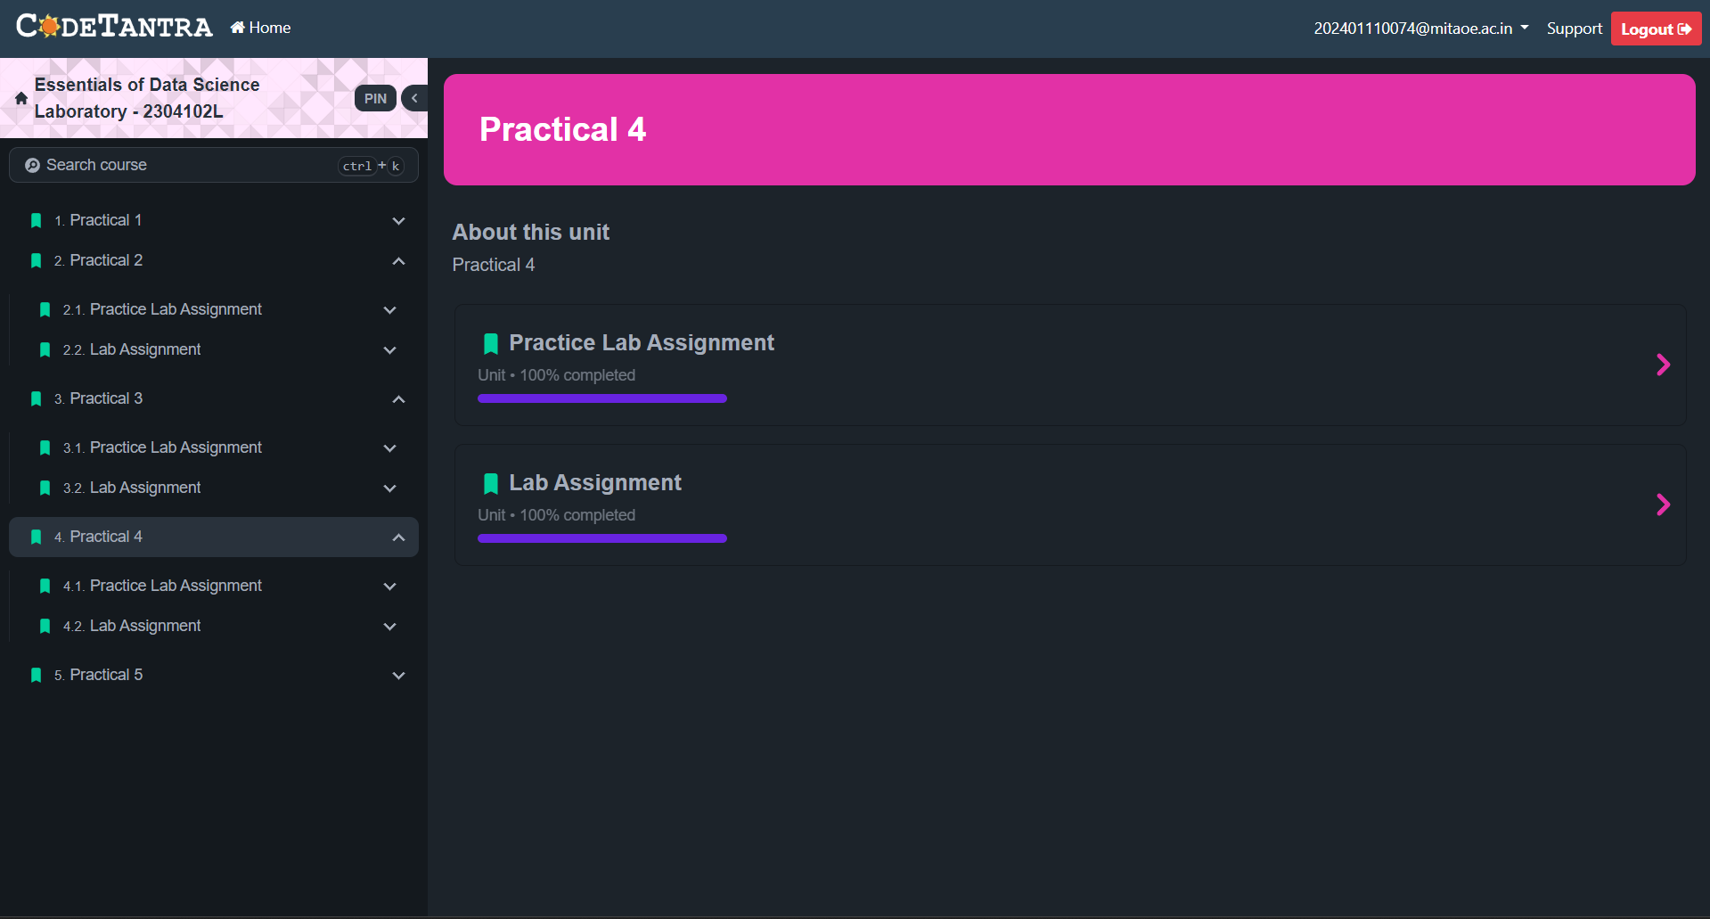

Slide 6
